Slide 1
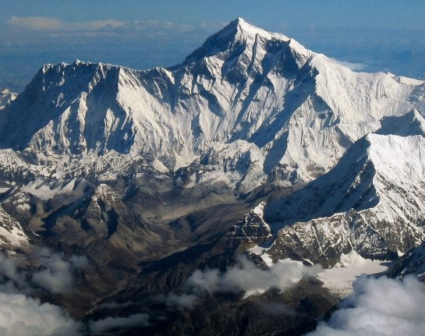
Modeling the relationship between tectonic uplift, albedo, and heat transfer on regional surface temperature
By Maddie Schwarz
ATOC 4850: Numerical Methods and Modelling

Slide 2
Background: Tectonics and Climate
Mountain building influences Earth’s climate and surface temperatures through geological time
Increases in elevation impact surface temperature due to more snow and ice landcover
EBM can be used to specifically evaluate the impact of elevation on albedo, and subsequently surface temperature

Slide 3
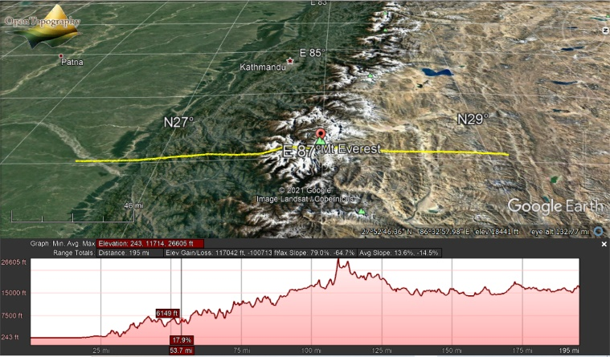
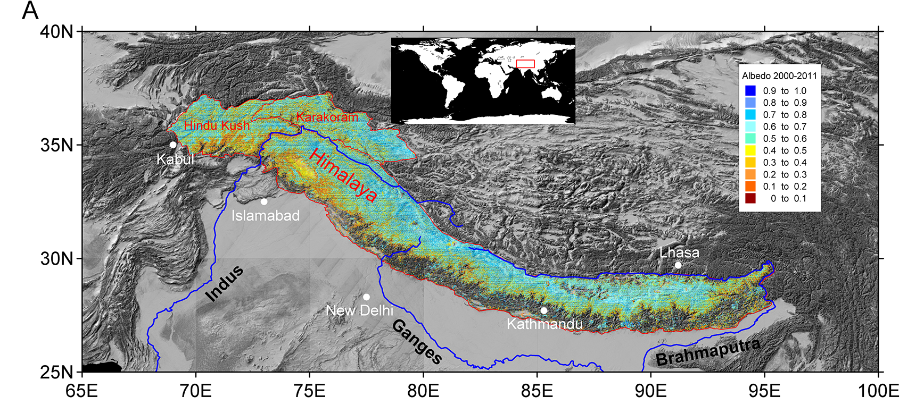
Background: Himalayan Orogeny
Started 50 million years ago
Global surface temperatures 9-14 degrees C warmer than present
Modern elevation and albedo values of Mount Everest region
“End point” of EBM model
Albedo ranges from 0 to 0.8
Elevation ranges ~74m to ~8,000 m

Slide 4

Model Details
Goal of model: Use current albedo and elevation data to simulate the Himalayan orogeny and evaluate reasonability model’s resulting surface temperatures
EBM model using non equilibrium heat transfer equation:
$\overline{C} \frac{∂T}{∂t}=\frac{S0}{4}s\left(y\right)\left(1−α\right)−\left(1−\frac{ε}{2}\right)σT^{4}−\frac{∂}{∂y}\left(−d\left(y\right)\frac{∂T}{∂y}\right)$
Albedo is elevation dependent
$α=0.8−0.799\exp{(−\frac{E}{65.0057})}$
Model time duration: 50 million years
Time Step: 1 million years
Integration Method: ‘BDF’
RK4 was unstable

Slide 5
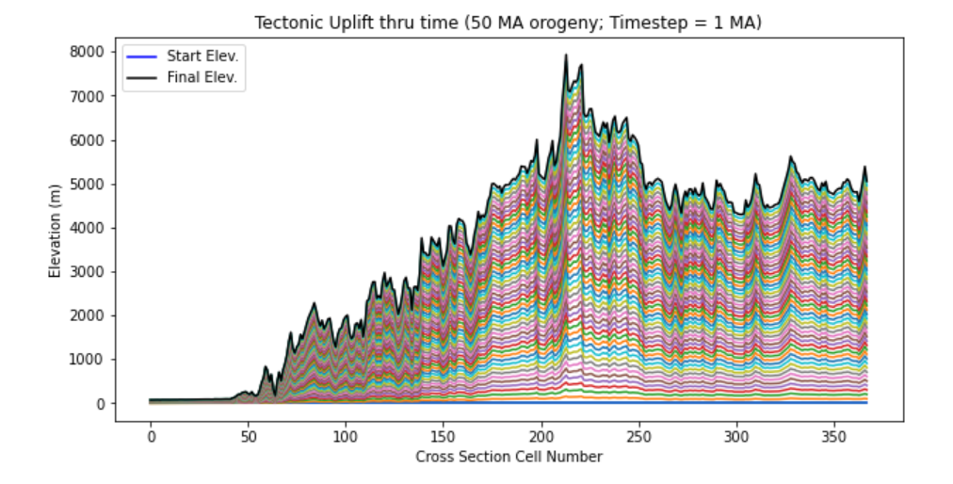
Model Results: Elevation

Slide 6
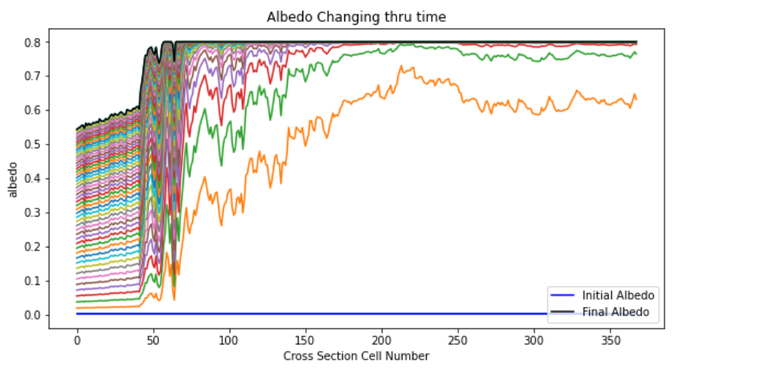
Model Results: Albedo

Slide 7
Results from albedo equation are consistent with data

Slide 8
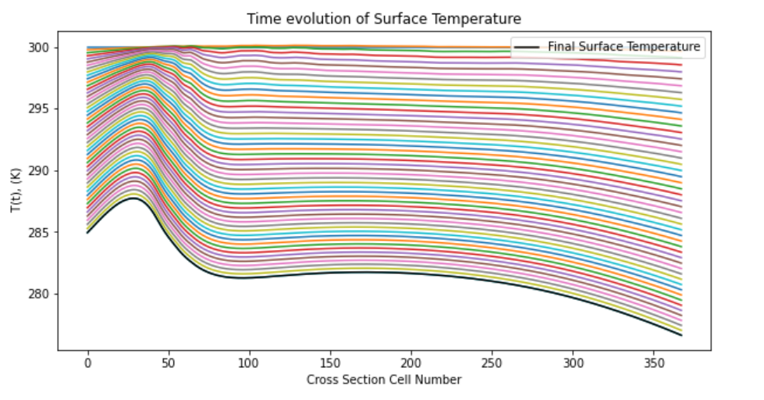
Model Results: Surface temperature

Slide 9
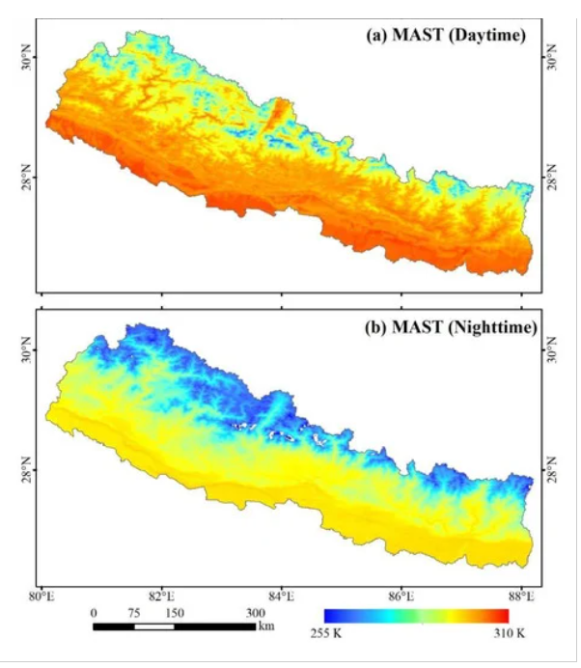
Implications
Uplift from the Himalayan orogeny resulted in overall cooler temperatures for the cross-section region
Particularly for uplifted mountain peaks and plateau
Resulting surface temperatures are fairly consistent with current measured average temperatures of region
Average surface temperatures from MODIS

Slide 10
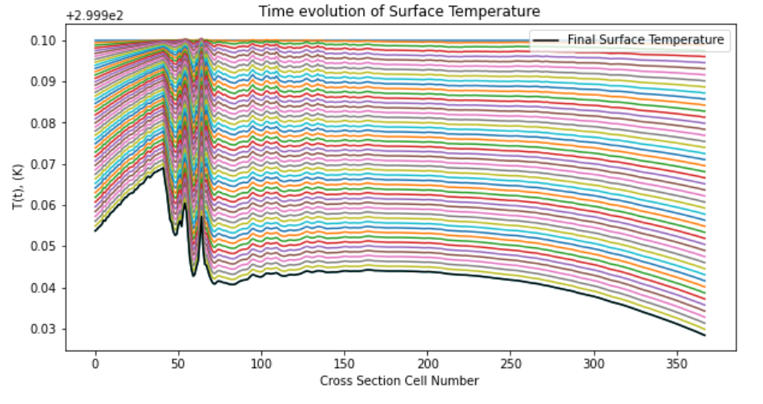
Possible Errors and Improvements to Model
Depth of the land layer is fixed– land depth is set to 100m which is low, producing a very simplified model.
Modify model to have elevation dependent heat capacity parameter
will require the model to run past the 50-million-year mark to account for the delay in diffusion
Ex: changing depth parameter to 40,000m (40km is avg oceanic crust thickness) shows surface temperature changes much slower through time

Slide 11
References
Arnold, Neil et al. (2006). “Topographic controls on the surface energy balance of a high Arctic valley Glacier.” J. Geophysics Rex, 111, F02011, doi: https://doi.org/10.1029/2005JF000426
DeConto R.M. (2009) Plate Tectonics and Climate Change. In: Gornitz V. (eds) Encyclopedia of Paleoclimatology and Ancient Environments. Encyclopedia of Earth Sciences Series. Springer, Dordrecht. doi: https://doi.org/10.1007/978-1-4020-4411-3_188
Yue, Xiaoying et al. (2020). “Variation in Albedo and Its Relationship With Surface Dust at Urumqi Glacier No. 1 in Tien Shan, China.” Frontiers in Earth Science, 8, 110. doi: https://www.frontiersin.org/article/10.3389/feart.2020.00110

